Slide 1

“Optimizing Netflix with Data Analytics”
A 24 hour deep dive by Urja Damodhar

Slide 2






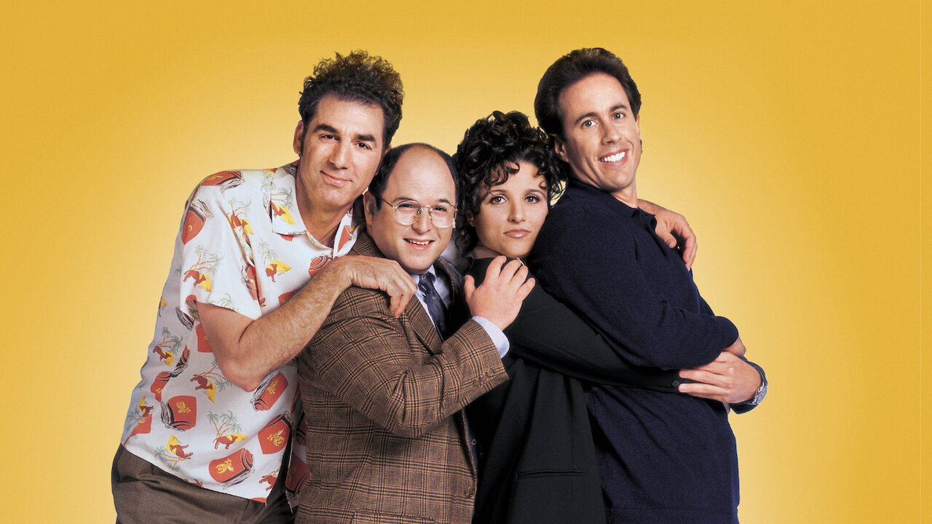


My 24-Hour Research & Execution
Problem Statement:
Netflix leverages data to optimize content recommendations, pricing, and user engagement. Challenges: user churn, pricing inefficiencies, and content investment require deeper analysis.
Outcome:
Built interactive Power BI dashboards to visualize subscription and content performance.
Designed an 8-stage Netflix Data Pipeline for real-time and batch processing.
Analyzed regional pricing trends and user behavior to optimize Netflix’s revenue strategy.
Possibilities:
Dynamic pricing models based on real-time user behavior and market trend(Region Specific).
Expanding revenue streams through strategic partnerships and interactive content.

Slide 3




Data Phase I
Data Sources
Data Ingestion Layer
Data Processing & Transformation (ETL)
Data Storage & Warehousing (Load)
User Activity Logs
Subscription & Billing Data
Content Performance
Marketing & Customer Support Data
External APIs (social media mentions, news, competitor data)
Streaming (Real-time Analytics)
Apache Kafka / Kinesis – Captures real-time user interactions.
Flink / Spark Streaming – Processes data as it arrives.
Batch Processing (Historical Data)
AWS S3 / Google Cloud Storage – Stores raw data.
Airflow / Prefect – Schedules batch data collection.
Apache Spark / Databricks – Processes large datasets efficiently.
dbt (Data Build Tool) – Applies data modeling & transformations.
SQL-based Transformations – Cleans, normalizes, and aggregates data.
Cloud Data Warehouses for analytical processing:
Amazon Redshift
Databricks Delta Lake (for real-time & batch data)

Slide 4




Data Phase II
Data Modeling & Business Intelligence
Machine Learning & Predictive Analytics
Live Deployment
Stakeholder Reporting & Feedback
Star & Snowflake Schema for analytics-ready data.
KPI Metrics: Monthly revenue, watch time, churn rate, popular genres.
BI Tools: Power BI, Tableau, Looker for data visualization.
User Segmentation & Recommendation Models using MLflow & TensorFlow.
Churn Prediction & Anomaly Detection with Scikit-Learn & PySpark ML.
Deploy ML models, real-time analytics, & dashboards
CI/CD, MLOps (Kubeflow, Airflow, Docker, AWS Lambda)
Present insights, receive feedback & optimize models
Executive Dashboards, Reports, A/B Testing

Slide 5
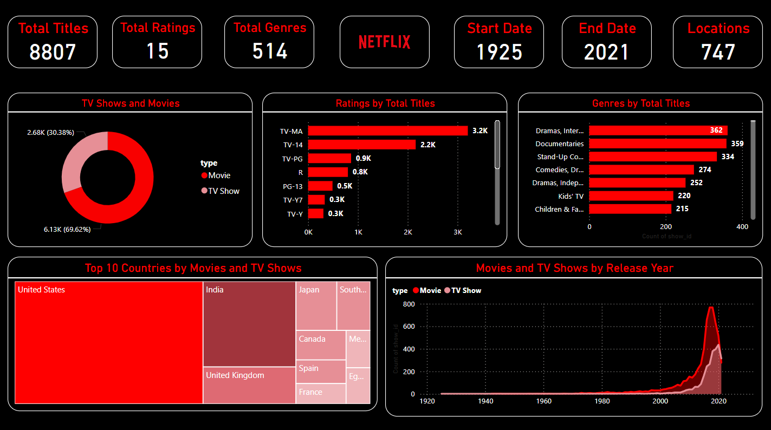
Content Dashboard
TOP RATINGS BY TITLES
TOP GENRES BY CONTENT
TV-MA 3.2 K Titles
Drama,Documentaries,Stand-Up Comedy
From total of 8.8 K
from 1055 Titles

Slide 6
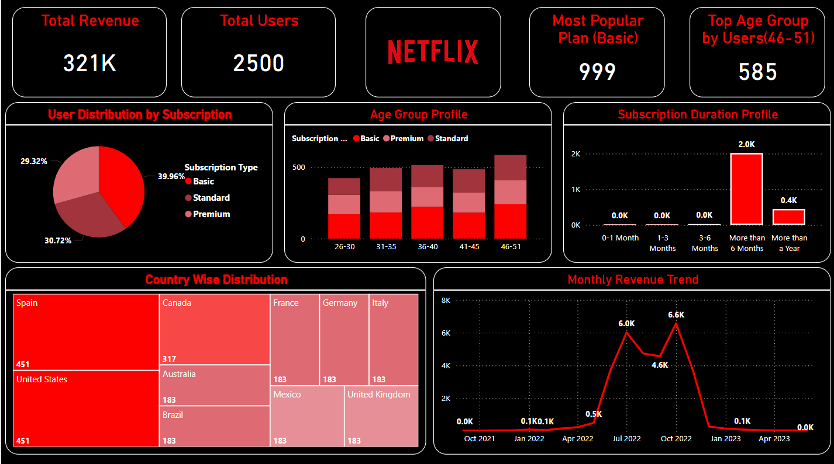
Subscription & Revenue Dashboard
Total Revenue
Most Popular Plan
$ 321 K
Basic $10
In 21 months (2500 users)
from 999 Users

Slide 7
User Base Statistics
Q3 2024 Report: India VS USA
Mobile
Basic
Standard
Premium
Only India
India | USA
India | USA
India | USA
Price
$2.40
$5.75
$7.99
$8.05
$17.99
$11.50
$17.99
Video Quality
Good
Good
Better
Best
Resolution
480p
720p
1080p
4K HDR
Number of Devices
1
1
2
4
India | USA
Total Subscribers
12 Million
66.7 Million
Total Revenue
$345 Million
$14 Billion

Slide 8
Key Business Insights & Recommendations
Recommendations:
Focus investment on high-retention content genres.
Optimize pricing based on regional revenue trends. E.g. Indian User Base VS USA User Base.
Enhance personalized recommendations to boost engagement.
Use real-time analytics to adjust marketing & content strategies.

Slide 9
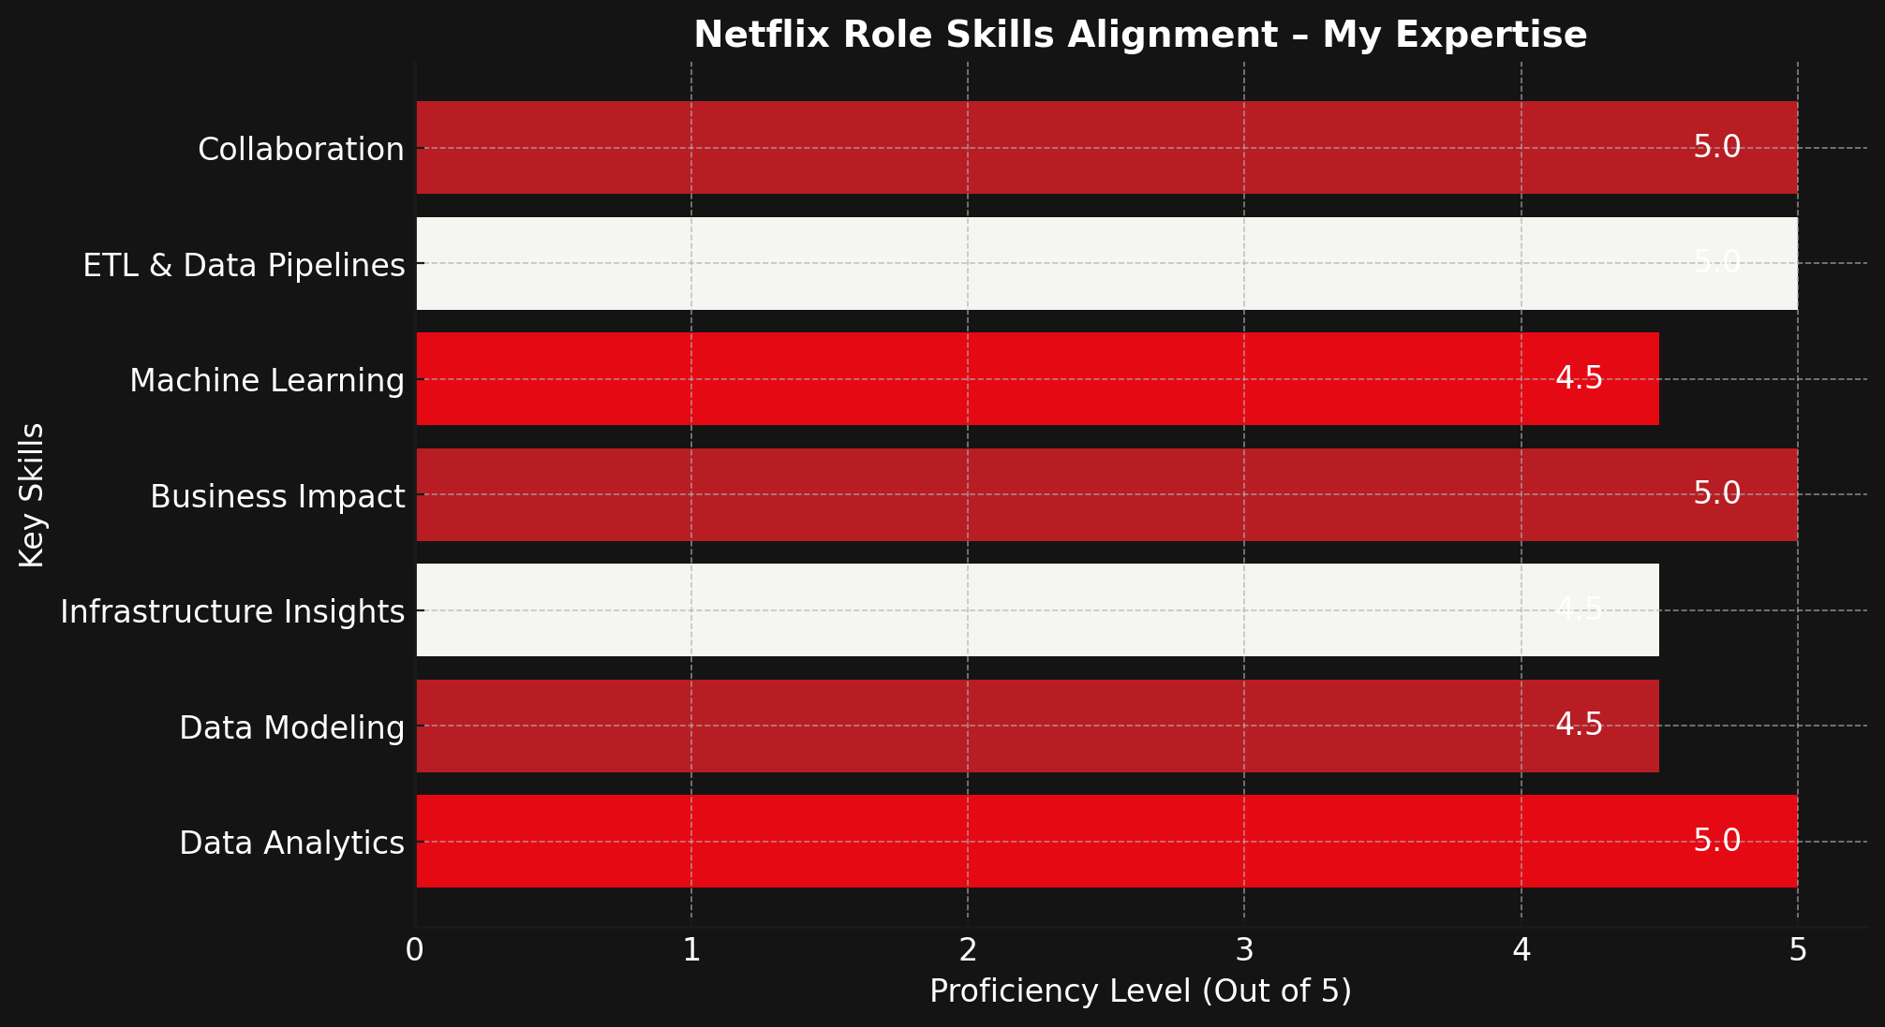

My Stats
I analyzed Netflix’s Analytics & Data Visualization Engineer role, mapping my skills to their needs. With expertise in SQL, Power BI, ML, and AWS, I build scalable pipelines, predictive models, and insightful dashboards to optimize cost & infrastructure efficiency.
Highest Qualification
TOP Skills
MSc. In Applied Data Analytics
Data Analytics,Visualization,Business Intelligence

Slide 10
Sources
Data
Template Credit
User Base Data
Content Data
Netflix Template
Research
ISPs around Globe for great Viewing Experience
Data Driven UI-UX Netflix
Cloud Pivot helps Revenue Boom
Day in life of Analytics Engineer
Data And Netflix
Netflix on AWS

Slide 11
Urja Damodhar | Analytics | Data Visualization Engineer
Contact: urjadd@bu.edu LinkedIn: Urja Damodhar

